Slide 1
POC for Lina
Client side
2015.09. ~2015.10.
Hyunju Yang

Slide 2
Timeline
https://developer.ibm.com/mobilefirstplatform/documentation/getting-started-7-1/quality-assurance/
https://developer.ibm.com/mobilefirstplatform/documentation/getting-started-8-0/quality-assurance/cordova/

Slide 3
2015.09.30
MQA
Push

Slide 4
MQA
https://developer.ibm.com/mobilefirstplatform/documentation/getting-started-7-1/quality-assurance/
https://developer.ibm.com/mobilefirstplatform/documentation/getting-started-8-0/quality-assurance/cordova/

Slide 5
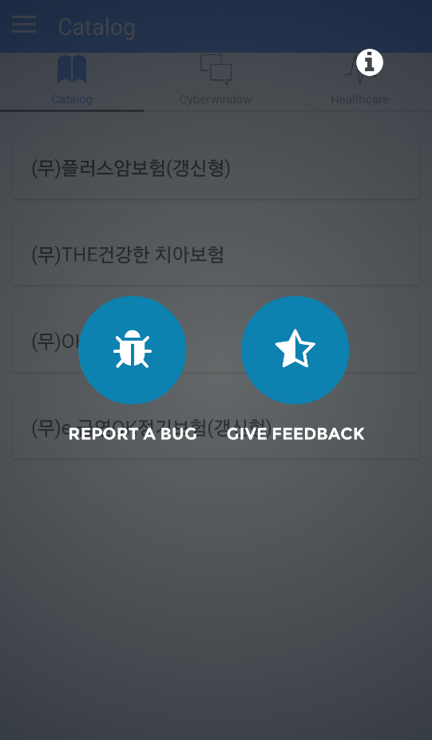
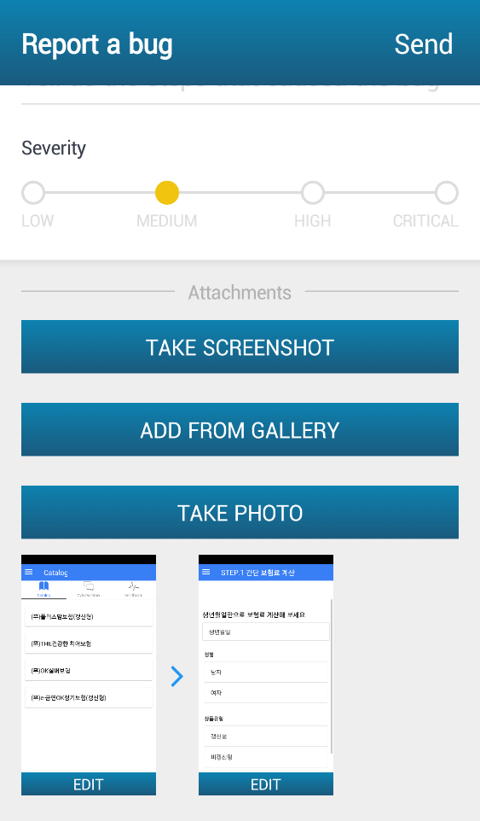
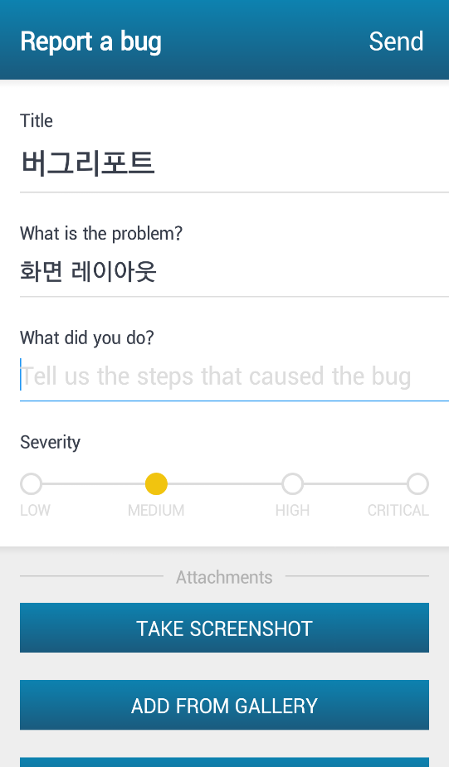
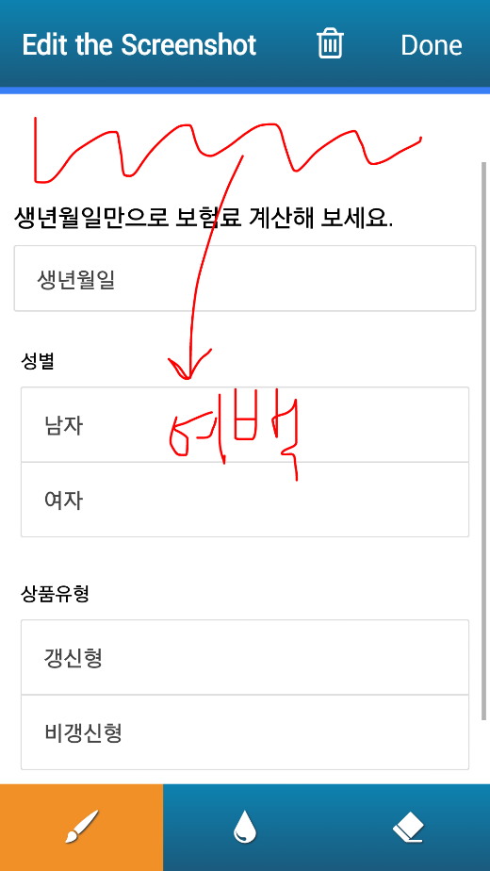
MQA

Slide 6
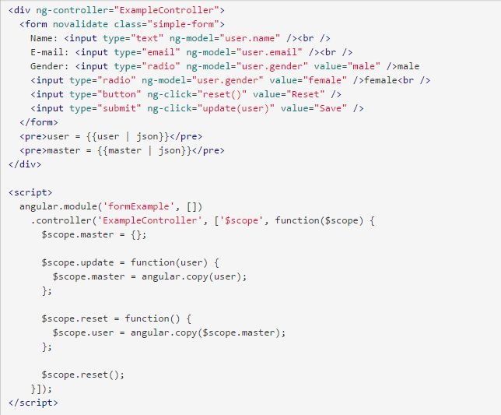
참고 링크
Ng-data form
https://docs.angularjs.org/guide/forms

